Slide 1






City of Cleveland
Department of Law
Budget Hearings
2026
clevelandohio.gov

Slide 2




Agenda
Departmental Overview
Core Initiatives and 2025 Progress
Staffing Levels
clevelandohio.gov

Slide 3
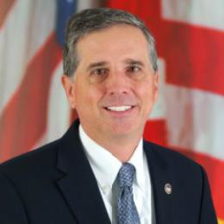
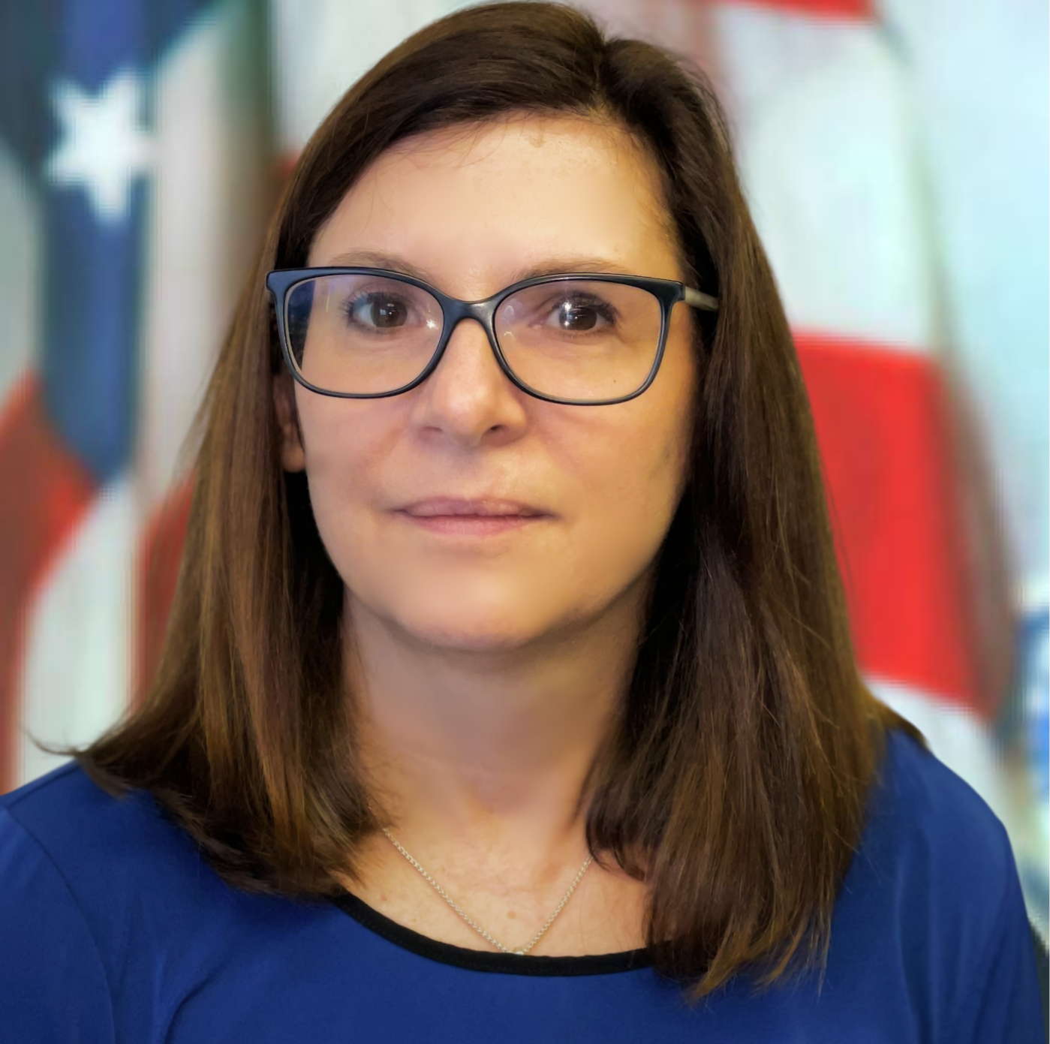
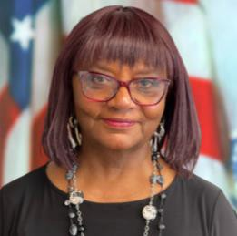
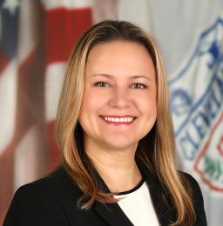
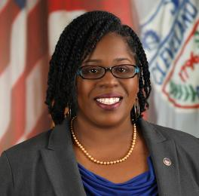
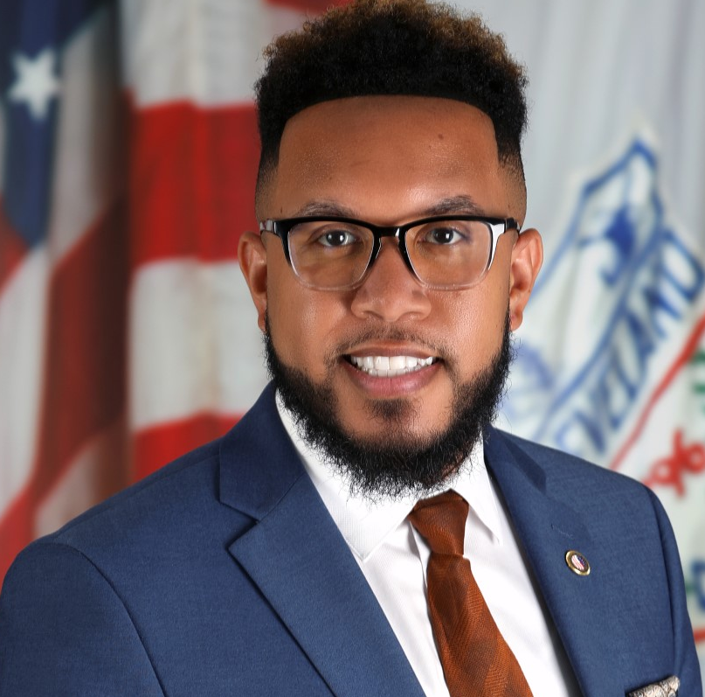
Departmental Overview
Under the Director of Law, the department represents and provides legal advice to the Mayor, City Council, and all City departments, boards and commissions. In addition to protecting taxpayer dollars through proactive and defense litigation, the Law Department prosecutes crimes in an effort to improve the quality of life for the City’s residents and visitors.
Civil Division
The Chief Corporate Counsel leads the transactional areas and serves as Acting Law Director in the Law Director’s absence. The Chief Trial Counsel leads all litigation areas.
Admin & Special Projects
The Chief Counsel manages department operations, budget, procurement and assists with other Law department projects.
Criminal Division
The Law Director serves as Chief Prosecutor for the City of Cleveland, but delegates that authority to the Chief Assistant Prosecutor.
Mark Griffin
Stephanie Melnyk
Michele Comer
Law Director
Chief Corporate Counsel
Chief Counsel
Ethics & Accountability
Led by Chief Ethics Officer who also assists in overseeing and representing the City in Consent Decree compliance.
Elena Boop
Aqueelah Jordan
Delanté Thomas
Chief Trial Counsel
Chief Prosecutor
Chief Ethics Officer
clevelandohio.gov

Slide 4
Core Initiatives and 2025 Progress
Litigation
Secured over $ 4 million in payments, including settlements and collections in claims/cases by the City including more than $1M in civil litigation payments to the City;
Saved the city hundreds of thousands of dollars by obtaining dismissals, favorable judgments and negotiated settlements;
Handled over 1,000 claims, subpoenas, litigation, and labor and employment matters in FY 2025.
Chief Assistant Director of Law: James R. Russell
Chief Assistant Director of Law: William Menzalora
Chief Assistant Director of Law: Tiffany Fischbach
Development
Assists City’s economic development efforts by counseling and crafting real estate and development transactions
Ex: Bedrock Development
Ex: Erieview Tower and Galleria Redevelopment
Chief Assistant Director of Law: Richard Bertovich
Code Enforcement
Focused on criminal code enforcement on nuisance properties
Ex: Aggressively enforced B/H codes against large property owner in Shaker Square resulting in sale to responsible buyer
Obtained judgment to enforce removal of underground tanks at abandoned gas stations
Ex: Enforced City’s nuisance ordinances against establishments that pose risk to public safety
Chief Assistant Director of Law: David Roberts
clevelandohio.gov

Slide 5
Core Initiatives and 2025 Progress
Operations & Sustainability
Assists Departments of Public Utilities, Public Works, Health, Parks & Recreation, and Sustainability
Ex: Completed over 220 contract assignments & 80+ pieces of legislation, including lease with Westside Market
Ex: Assisted Water Dept obtain low/no interest loans for lead line replacements
Ex: Assisted Cleveland Public Power develop and implement new arbitration panel
Chief Assistant Director of Law: Geraldine Butler
House Counsel
Counsels City regarding municipal law, finance, legislation, contracts, and tax prosecution. Drafts and approves legislation
Ex: Drafted legislation implementing changes to address safety/security in public garages and parking lots
Ex: Worked with Mayor, Health, & Planning to address location of smoke shops and tobacco licensing requirements
Ex: Provided guidance to Fair Employment Wage Board to address living wage, pay transparency, and wage theft laws.
Chief Assistant Director of Law: Kevin Roberts
Public Records
Received and processed 29,378 requests
26,117 for Public Safety
2,972 from media
WCS: 1,882 (136% increase since 2021)
Chair: Amy Hough
clevelandohio.gov

Slide 6
Core Initiatives and 2025 Progress
Criminal Division
Ethics & Accountability
Prosecutor’s Office
Responsible for prosecuting misdemeanor crimes, including domestic violence, assault, traffic offenses, and theft. Office reviews potential felony indictments for referral. Prosecutors review police use of deadly force and internal investigations to determine whether prosecution is fitting.
2025 Projects
Ex: Expansion of Central Booking – Added prosecutors and launched pilot program to double review time
Ex: Nat’l Violence Against Women Act partnership with CDP and County to expand services to victims of crime
Ethics Office
Provides advice and counsel to City officials, employees, and Boards/Commissions on issues involving the application of ethics laws and navigating conflicts of interest.
Ex: Responded to over 150 ethics law inquiries
Consent Decree
Represents City in Federal Consent Decree
Challenged Monitor bills to protect taxpayer dollars
Assisted in fulfilling large amounts of police records requests
Provided resources and support for Police Accountability Team
Provided legal support for civilian oversight bodies (CPC/CPRB/OPS)
clevelandohio.gov

Slide 7
Staffing
The City Law Department is divided into two divisions (criminal and civil) and two specialty areas (ethics and accountability). Staffing includes attorneys, paralegals, legal secretaries, investigators, claims examiners, clerks, and administrative assistants. Law Department headcount also includes Mayor’s Police Accountability Team (4)
2026 Budgeted Headcount | FTEs as of 1-30-26 | Current Vacancies
103 | 98 | 5
clevelandohio.gov

